Slide 1
ECE 5526: Speech Recognition
Acoustic Theory of Speech Production

Slide 2
Acoustic Theory of Speech Production
Overview
Sound sources
Vocal tract transfer function
Wave equations
Sound propagation in a uniform acoustic tube
Representing the vocal tract with simple acoustic tubes
Estimating natural frequencies from area functions of vocal tract
Representing the vocal tract with multiple uniform tubes

Slide 3
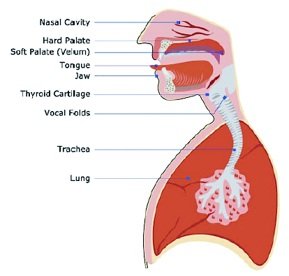
Anatomical Structures for Speech Production

Slide 4
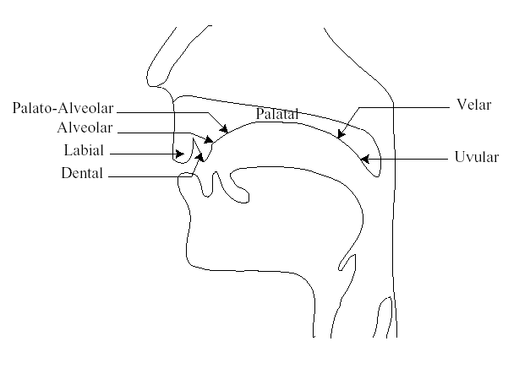
Places of Articulation for Speech Sounds

Slide 5
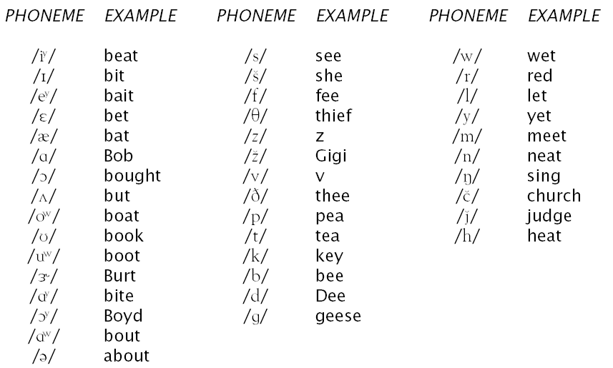
Phonemes in American English

Slide 6
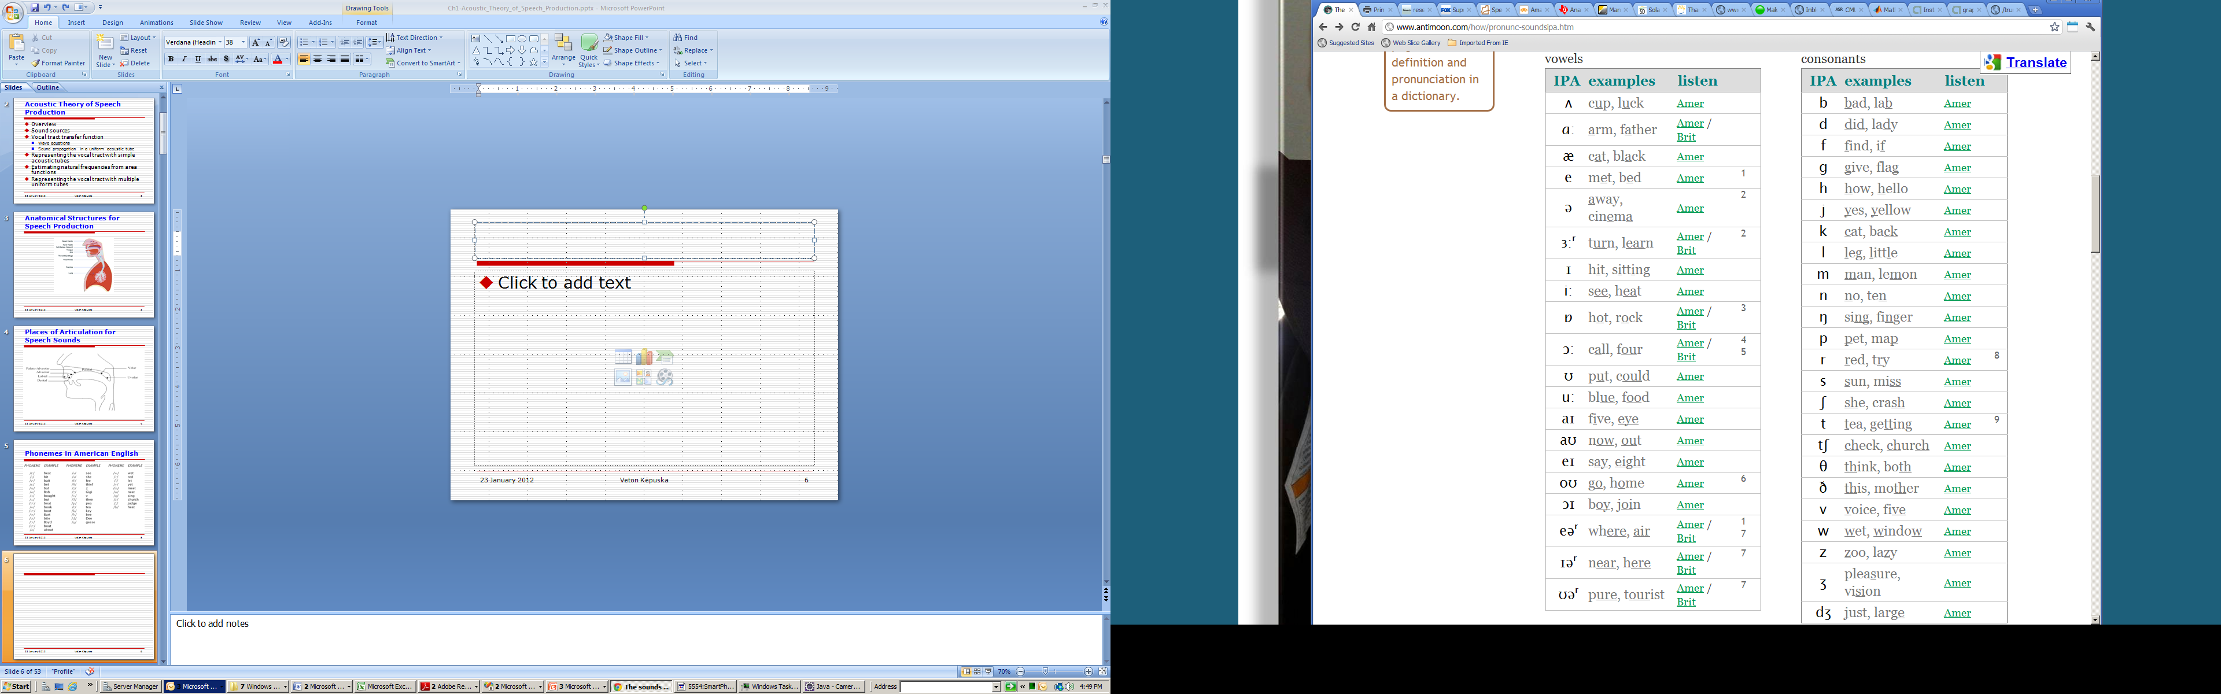
IPS Phonetic Alphabet

Slide 7
SPHYNX ARPA-BET Phone Set
Phoneme | Example | Translation
AA | odd | AA D
AE | at | AE T
AH | hut | HH AH T
AO | ought | AO T
AW | cow | K AW
AY | hide | HH AY D
B | be | B IY
CH | cheese | CH IY Z
D | dee | D IY
DH | thee | DH IY
EH | Ed | EH D
ER | hurt | HH ER T
EY | ate | EY T
F | fee | F IY
G | green | G R IY N
HH | he | HH IY
IH | it | IH T
IY | eat | IY T
JH | gee | JH IY
IH | it | IH T
IY | eat | IY T
Phoneme | Example | Translation
JH | gee | JH IY
K | key | K IY
L | lee | L IY
M | me | M IY
N | knee | N IY
NG | ping | P IH NG
OW | oat | OW T
OY | toy | T OY
P | pee | P IY
R | read | R IY D
S | sea | S IY
SH | she | SH IY
T | tea | T IY
TH | theta | TH EY T AH
UH | hood | HH UH D
UW | two | T UW
V | vee | V IY
W | we | W IY
Y | yield | Y IY L D
Z | zee | Z IY
ZH | seizure | S IY ZH ER

Slide 8
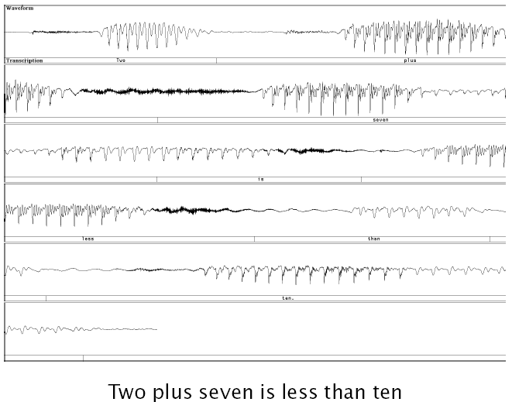
Speech Waveform: An Example

Slide 9
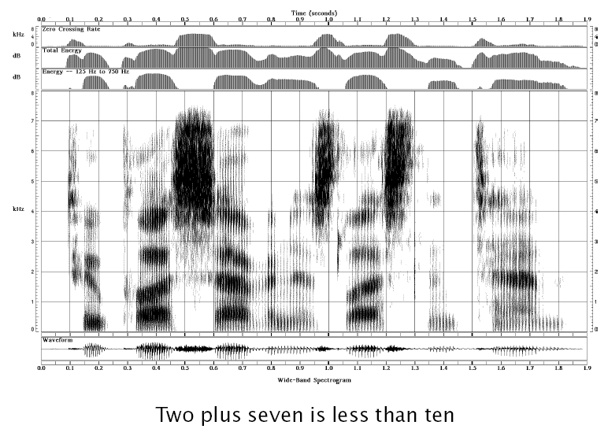
A Narowband Spectrogram

Slide 10
A Wideband Spectrogram

Slide 11
A Narrowband Spectrogram

Slide 12
Physics of Sound
Sound Generation:
Vibration of particles in a medium (e.g., air, water).
Speech Production:
Perturbation of air particles near the lips.
Speech Communication:
Propagation of particle vibrations/perturbations as chain reaction through free space (e.g., a medium like air) from the source (i.e., lips of a speaker) to the destination (i.e., ear of a listener).
Listener’s ear eardrum caused vibrations trigger series of transductions initiated by this mechanical motion leading to neural firing ultimately perceived by the brain.

Slide 13
Physics of Sound
A sound wave is the propagation of a disturbance of particles through an air medium (or more generally any conducting medium) without the permanent displacement of the particles themselves.
Alternating compression and rarefaction phases create a traveling wave.
Associated with disturbance are local changes in particle:
Pressure
Displacement
Velocity

Slide 14
Physics of Sound
Sound wave:
Wavelength, λ:
The distance between two consecutive peak compressions (or rarefactions) in space (not in time),
is also the distance the wave travels in one cycle of the vibration of air particles.
Frequency, f: is the number of cycles of compression (or rarefaction) of air particle vibration per second.
Wave travels a distance of f wavelengths in one second.
Velocity of sound, c: is thus given by c = f λ.
At sea level and temperature of 70ºF, c=344 m/s.
Wavenumber, k:
Radian frequency: Ω=2πf
Ω/c=2π/λ=k

Slide 15
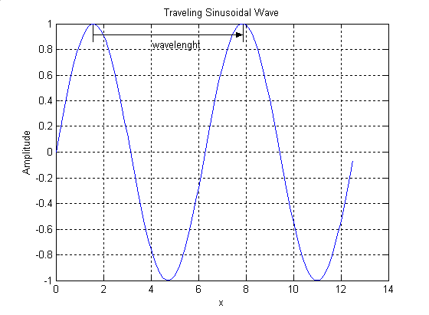
Traveling Wave
λ

Slide 16
Physics of Sound
Suppose the frequency of a sound wave is f = 50 Hz, 1000 Hz, and 10000 Hz. Also assume that the velocity of sound at sea level is c = 344 m/s.
The wavelength of sound wave is respectively: λ= 6.88 m, 0.344 m and 0.0344 m.
Speech sounds have wide range of wavelengths values:

Slide 17
Physics of Sound
Audio range:
f_{min} = 30 Hz ⇒ λ=11.5 m
f_{max} = 20 kHz ⇒ λ=0.0172 m

Slide 18
Review of Physics

Slide 19
Physics Review
To fully understand the various acoustical aspects of sound production, it is generally necessary to use powerful mathematical methods such as calculus.
However, it is possible to understand a great deal about the physical aspects of sound production with by introducing just a few simple concepts.

Slide 20
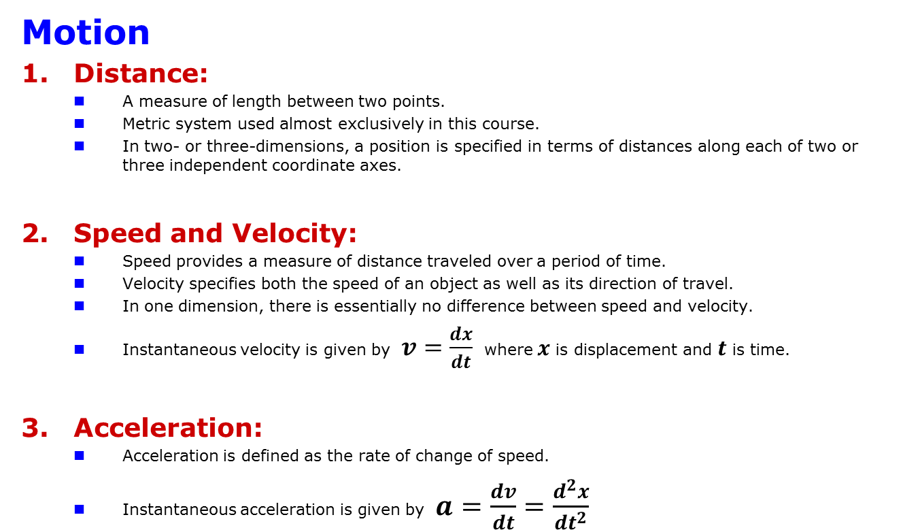
Physics Review
Motion
Distance:
A measure of length between two points.
Metric system used almost exclusively in this course.
In two- or three-dimensions, a position is specified in terms of distances along each of two or three independent coordinate axes.
Speed and Velocity:
Speed provides a measure of distance traveled over a period of time.
Velocity specifies both the speed of an object as well as its direction of travel.
In one dimension, there is essentially no difference between speed and velocity.
Instantaneous velocity is given by $v=\frac{dx}{dt}$where $x$ is displacement and $t$ is time.
Acceleration:
Acceleration is defined as the rate of change of speed.
Instantaneous acceleration is given by $a=\frac{dv}{dt}=\frac{d^{2}x}{{dt}^{2}}$

Slide 21
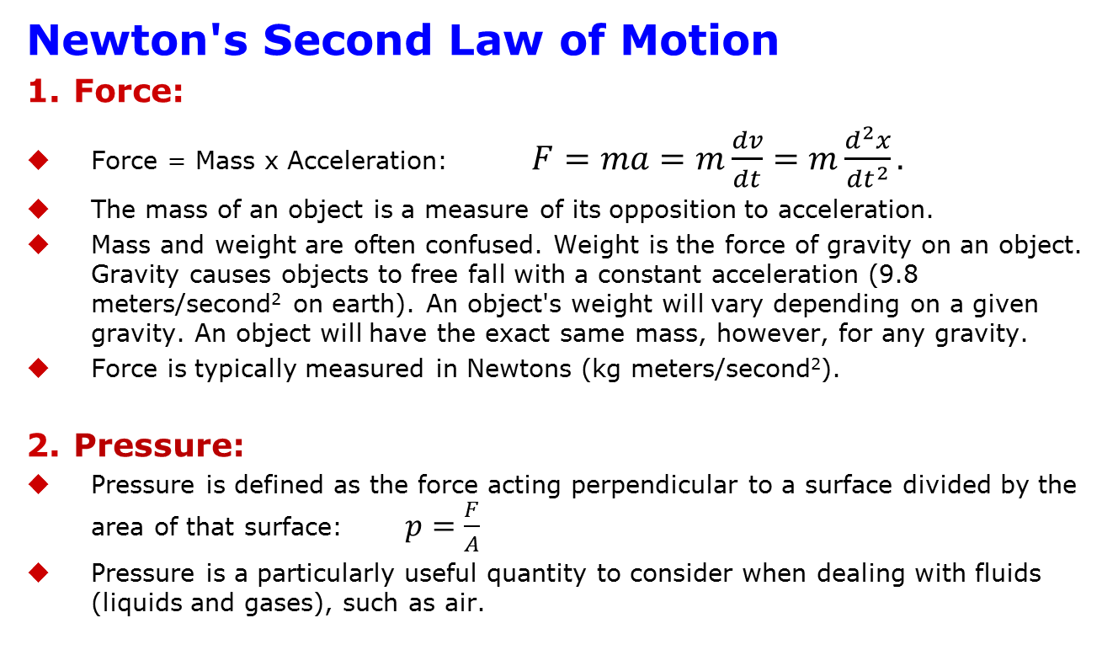
Physics Review
Newton's Second Law of Motion
Force:
Force = Mass x Acceleration: $F=ma=m\frac{dv}{dt}=m\frac{d^{2}x}{{dt}^{2}}.$
The mass of an object is a measure of its opposition to acceleration.
Mass and weight are often confused. Weight is the force of gravity on an object. Gravity causes objects to free fall with a constant acceleration (9.8 meters/second² on earth). An object's weight will vary depending on a given gravity. An object will have the exact same mass, however, for any gravity.
Force is typically measured in Newtons (kg meters/second²).
Pressure:
Pressure is defined as the force acting perpendicular to a surface divided by the area of that surface: $p=\frac{F}{A}$
Pressure is a particularly useful quantity to consider when dealing with fluids (liquids and gases), such as air.

Slide 22
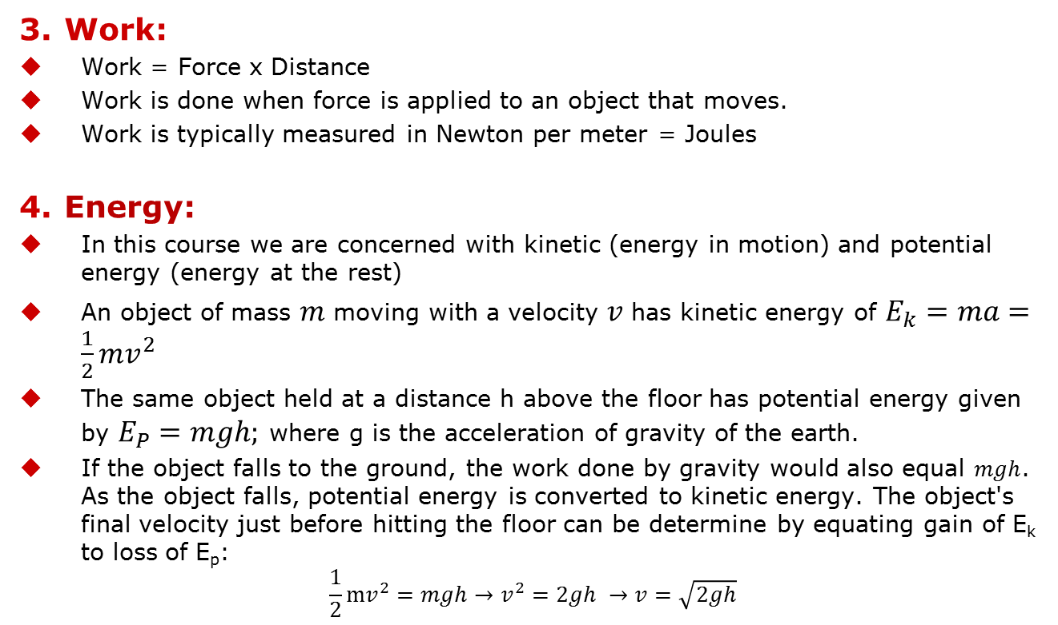
Work, Energy, & Power
Work:
Work = Force x Distance
Work is done when force is applied to an object that moves.
Work is typically measured in Newton per meter = Joules
Energy:
In this course we are concerned with kinetic (energy in motion) and potential energy (energy at the rest)
An object of mass $m$ moving with a velocity $v$ has kinetic energy of $E_{k}=ma=\frac{1}{2}{mv}^{2}$
The same object held at a distance h above the floor has potential energy given by $E_{P}=mgh;$ where g is the acceleration of gravity of the earth.
If the object falls to the ground, the work done by gravity would also equal $mgh$. As the object falls, potential energy is converted to kinetic energy. The object's final velocity just before hitting the floor can be determine by equating gain of E_{k} to loss of E_{p}:
$$\frac{1}{2}mv^{2}=mgh→v^{2}=2gh →v=\sqrt{2gh}$$

Slide 23
Work, Energy, & Power
Power:
Power = Work / Time
Power relates to the rate at which work is done
Power is measure in “Watts” = Joules/second

Slide 24
Modeling of Speech Propagation

Slide 25
Sound
In physics:
sound is a vibration that propagates as a typically audible wave of pressure and displacement, through a medium such as air or water.
In physiology and psychology:
sound is the reception of such waves and their perception by the brain

Slide 26
Adiabatic Process
In audible range a propagation of sound wave is considered to be an adiabatic process, that is,
heat generated by particle collision during pressure fluctuations, has no time to dissipate away and therefore temperature changes occur locally in the medium.

Slide 27
Definition:
Sound is defined by ANSI/ASA S1.1-2013 as:
Oscillation in pressure, stress, particle displacement, particle velocity, etc., propagated in a medium with internal forces (e.g., elastic or viscous), or the superposition of such propagated oscillation.
Auditory sensation evoked by the oscillation described previously.

Slide 28
Physics of Sound
The sound waves are generated by a sound source, such as the vibrating diaphragm of a stereo speaker. The sound source creates vibrations in the surrounding medium. As the source continues to vibrate the medium, the vibrations propagate away from the source at the speed of sound, thus forming the sound wave.
At a fixed distance from the source, the pressure, velocity, and displacement of the medium vary in time. At an instant in time, the pressure, velocity, and displacement vary in space.
Note that the particles of the medium do not travel with the sound wave. This is intuitively obvious for a solid, and the same is true for liquids and gases; that is, the vibrations of particles in the gas or liquid transport the vibrations, while the average position of the particles over time does not change.
During propagation, waves can be reflected, refracted, or attenuated by the medium.^{[4]}

Slide 29
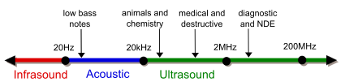
Sound Propagation
The behavior of sound propagation is generally affected by three things:
Sound exhibits a complex relationship between the density and pressure of the medium. This relationship, affected by temperature, determines the speed of sound within the medium.
Sound is dependent on Motion of the medium itself. If the medium is moving, this movement may increase or decrease the absolute speed of the sound wave depending on the direction of the movement
Sound also is affected by the viscosity of the medium. Medium viscosity determines the rate at which sound is attenuated. For many media, such as air or water, attenuation due to viscosity is negligible.

Slide 30

Physics of Sound
Although there are many complexities relating to the transmission of sounds, at the point of reception (i.e. the ears), sound is readily dividable into two simple elements: pressure and time.
These fundamental elements form the basis of all sound waves. They can be used to describe, in absolute terms, every sound we hear.
Spherical compression (longitudinal) waves

Slide 31
Speed of Sound
The speed of sound depends on the medium that the waves pass through, and is a fundamental property of the material.
French mathematician Laplace deduced that the phenomenon of sound travelling is not isothermal, as believed by Newton, but adiabatic process.
An adiabatic process is one that occurs without transfer of heat or matter.

Slide 32
Speech Production

Slide 33
Speech Production
The human speech production system

Slide 34
The Vocal Tract
Nasal Cavity
Oral Cavity
Pharyngeal Cavity

Slide 35
Speech Production
The vocal tract, consisting of both the oral and nasal airways (see figure in previous slide), can serve as a time-varying acoustic filter that suppresses the passage of sound energy at certain frequencies while allowing its passage at other frequencies.
Formants are those frequencies at which local energy maxima are sustained by the vocal tract and are determined, in part, by the overall shape, length and volume of the vocal tract.
The detailed shape of the filter (transfer) function is determined by the entire vocal tract serving as an acoustically resonant system combined with losses including those due to radiation at the lips.

Slide 36
Speech Production
An idealized filter function for the neutral vowel is shown in the center panels of Figure in next slide for a vocal tract approximately 17cm long, approximated by a uniform tube.
The formant frequencies, corresponding to the peaks in the function, represent the center points of the main bands of energy that are passed by a particular shape of the vocal tract.
In this idealized case, they are 500, 1500 and 2500 Hz with bandwidths of 60 to 100 Hz, and are the same regardless of the fundamental frequency (i.e., they are the same in both the top and bottom center panels).

Slide 37
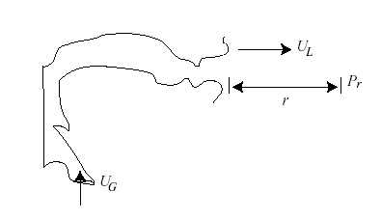
Acoustic Theory of Speech Production
The acoustic characteristics of speech are usually modeled as a sequence of source, vocal tract filter, and radiation characteristics
P_{r} (jΩ) = S(jΩ) T (jΩ) R(jΩ)
For vowel production:
S(jΩ) = U_{G}(jΩ)
T (jΩ) = U_{L}(jΩ) /U_{G}(jΩ)
R(jΩ) = P_{r} (jΩ) /U_{L}(jΩ)
Source
S(jΩ)
Filter
T(jΩ)
Radiation
R(jΩ)

Slide 38
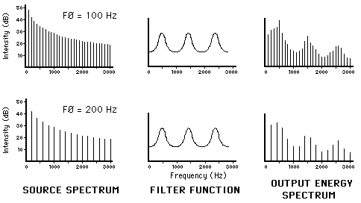
Source Filter Model
The source-filter model of speech production.

Slide 39
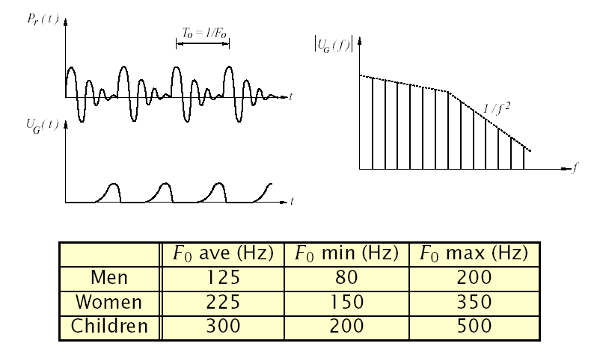
Sound Source: Vocal Fold Vibration
Modeled as a volume velocity source at glottis, U_{G}(jΩ)

Slide 40
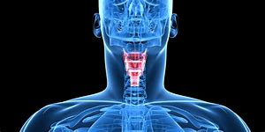
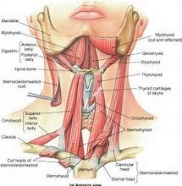
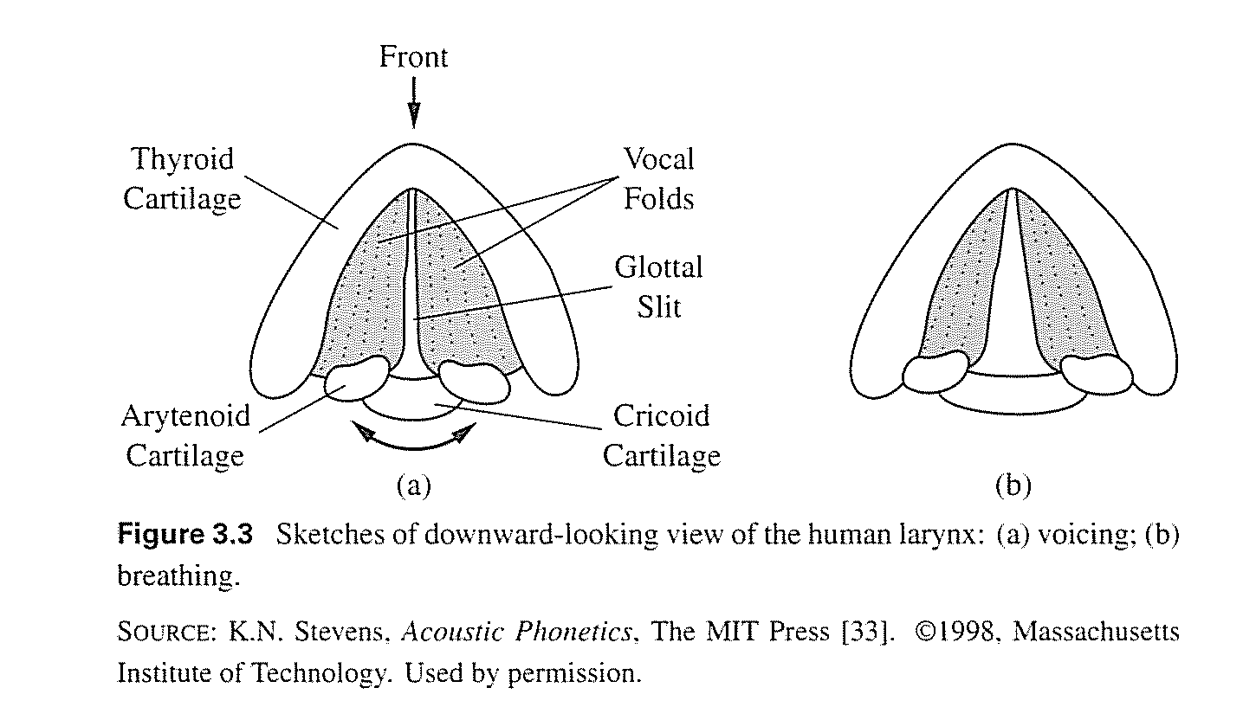
Anatomy and Physiology of Speech Production
Larynx
Complicated system of cartilages, flesh, muscles, and ligaments.
Primary function (in context of speech production) is to control the vocal cords (vocal folds) as illustrated in Figure 3.3.
Vocal folds are:
~15 mm in men
~13 mm in women

Slide 41
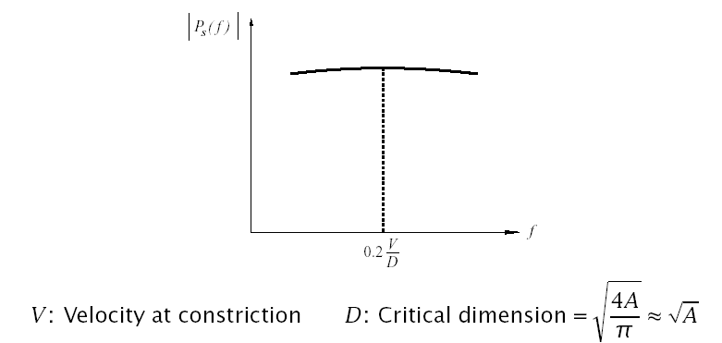
Sound Source: Turbulence Noise
Turbulence noise is produced at a constriction in the vocal tract
Aspiration noise is produced at glottis
Frication noise is produced above the glottis
Modeled as series pressure source at constriction, P_{S}(jΩ)

Slide 42
Vocal Tract Wave Equations
Define:
u(x,t) ⇒ particle velocity
U(x,t) ⇒ volume velocity (U = uA)
p(x,t) ⇒ sound pressure variation (P = P_{O} + p)
ρ ⇒ density of air
c ⇒ velocity of sound
Assuming plane wave propagation (for across dimension ≪ λ), and a one-dimensional wave motion, it can be shown that:

Slide 43
The Plane Wave Equation
First form of Wave Equation:
Second form is obtained by differentiating equations above with respect to x and t respectively:

Slide 44
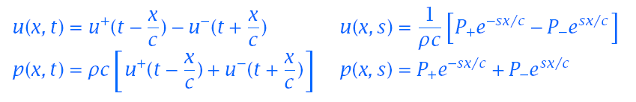
Solution of Wave Equations

Slide 45
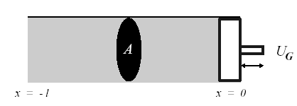
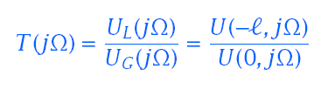
Propagation of Sound in a Uniform Tube
The vocal tract transfer function of volume velocities is

Slide 46
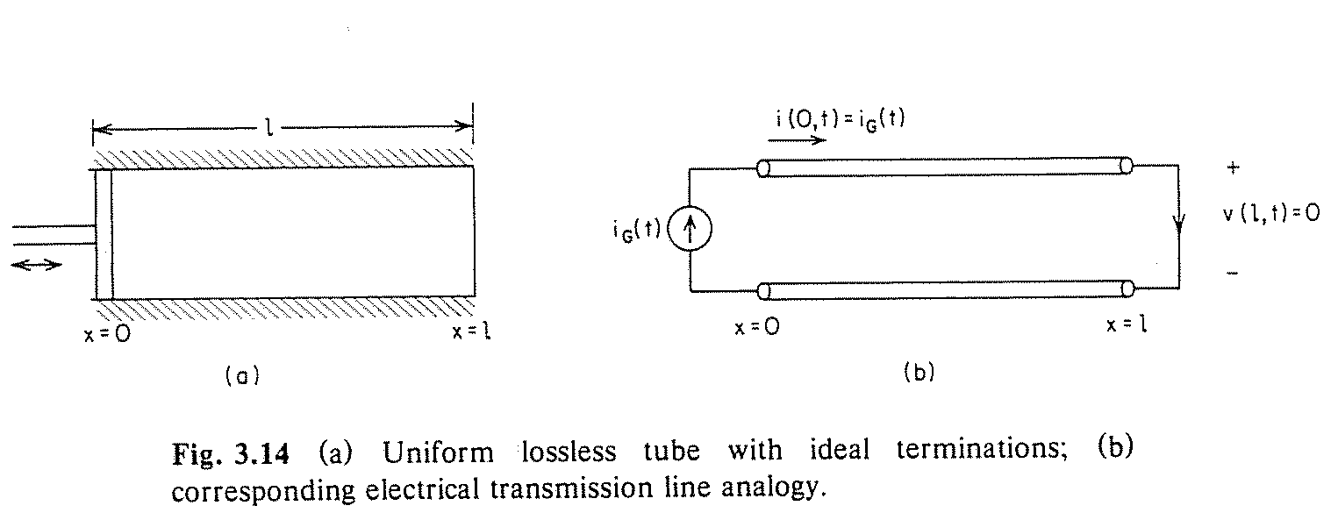
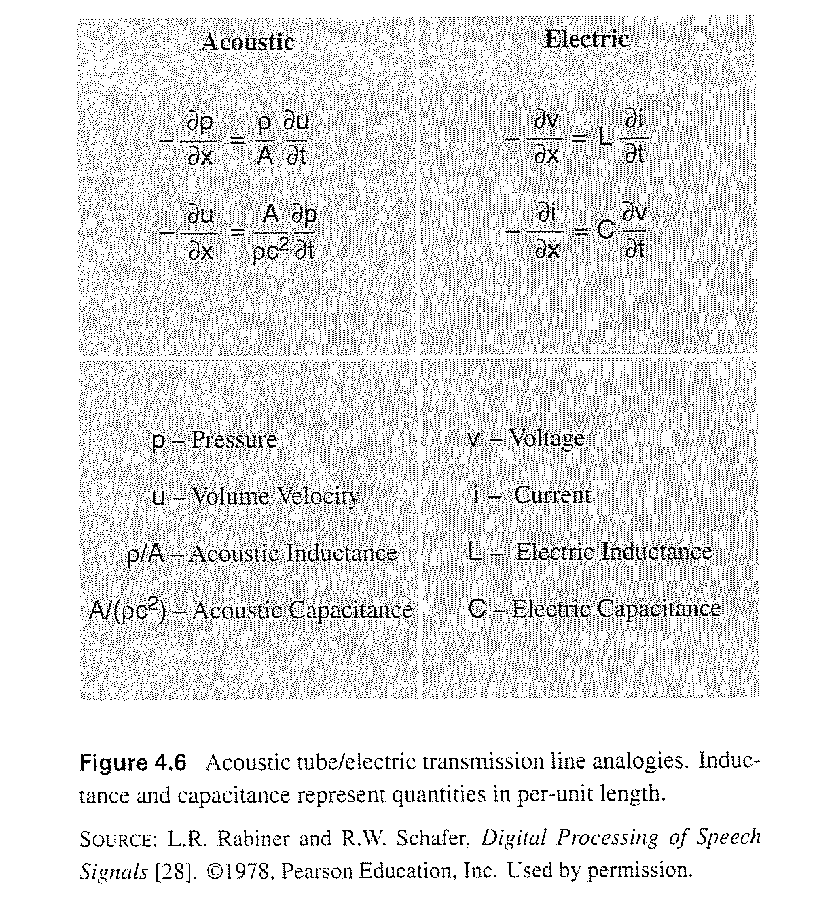
Analogy with Electrical Circuit Transmission Line

Slide 47
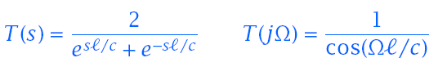
Propagation of Sound in a Uniform Tube
Using the boundary conditions U (0,s)=U_{G}(s) and P(-l,s)=0
The poles of the transfer function T (jΩ) are where cos(Ωl/c)=0

Slide 48
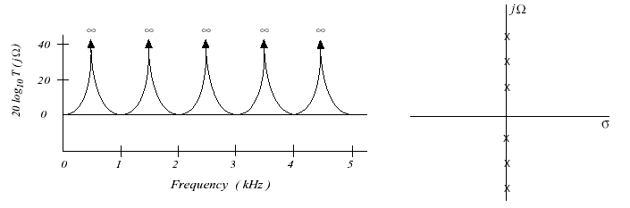
Propagation of Sound in a Uniform Tube (con’t)
For c =34,000 cm/sec, l =17 cm, the natural frequencies (also called the formants) are at 500 Hz, 1500 Hz, 2500 Hz, …
The transfer function of a tube with no side branches, excited at one end and response measured at another, only has poles
The formant frequencies will have finite bandwidth when vocal tract losses are considered (e.g., radiation, walls, viscosity, heat)
The length of the vocal tract, l, corresponds to (1/4)λ₁, (3/4)λ₂, (5/4)λ₃, …, where λ_{i} is the wavelength of the ith natural frequency

Slide 49

Uniform Tube Model
Example
Consider a uniform tube of length l=35 cm (0.35 m). If speed of sound is 350 m/s calculate its resonances in Hz. Compare its resonances with a tube of length l = 35/2 cm = 17.5 cm.
l=35,f=Ω/2π⇒

Slide 50
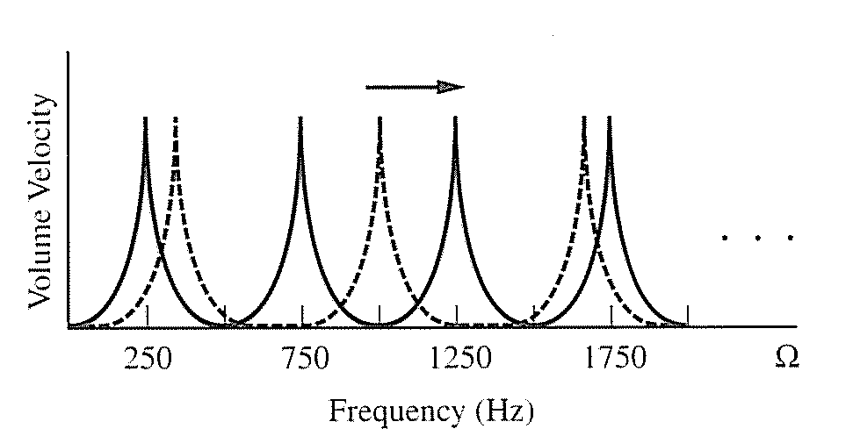
Uniform Tube Model
For 17.5 cm tube:

Slide 51
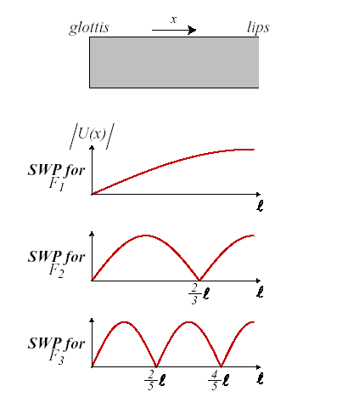
Standing Wave Patterns in a Uniform Tube
A uniform tube closed at one end and open at the other is often referred to as a quarter wavelength resonator

Slide 52
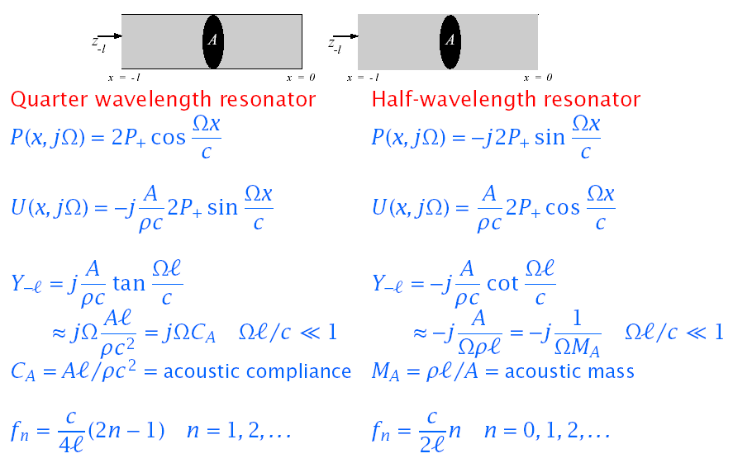
Natural Frequencies of Simple Acoustic Tubes

Slide 53
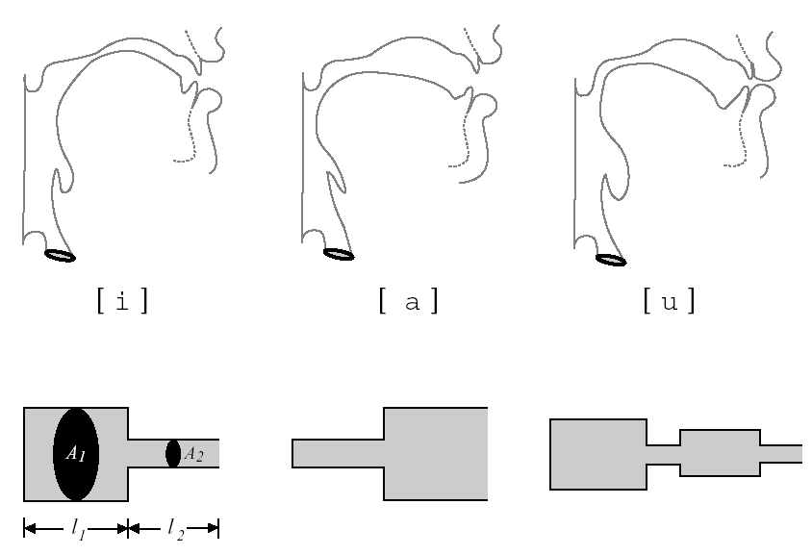
Approximating Vocal Tract Shapes

Slide 54
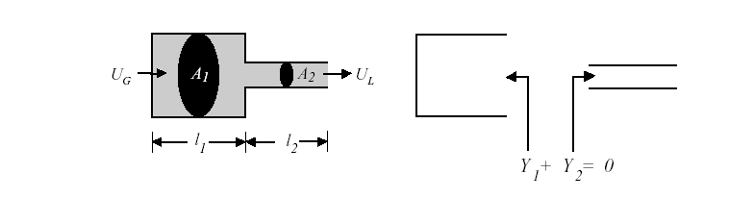
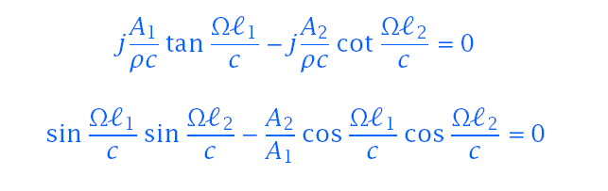
Estimating Natural Resonance Frequencies
Resonance frequencies occur where impendence (or admittance) function equals natural (e.g., open circuit) boundary conditions
For a two tube approximation it is easiest to solve for Y₁ + Y₂ = 0.

Slide 55
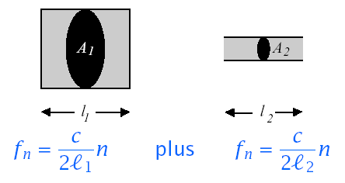
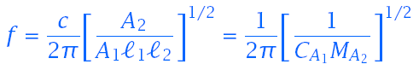
Decoupling Simple Tube Approximations
If A1≫A2,or A1≪A2, the tubes can be decoupled and natural frequencies of each tube can be computed independently
For the vowel /i^{y}/, the formant frequencies are obtained from:
At low frequencies:
This low resonance frequency is called the Helmholtz resonance.

Slide 56
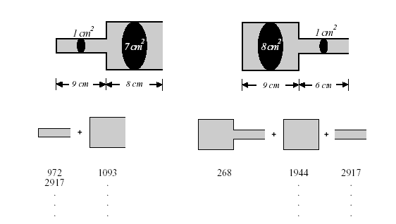
Vowel Production Example
Example: “Bit”
Example: “Bat”
Formant | Actual | Estimated | Formant | Actual | Estimated
F1 | 789 | 972 | F1 | 256 | 268
F2 | 1276 | 1093 | F2 | 1905 | 1944
F3 | 2808 | 2917 | F3 | 2917 | 2917
… | … | … | … | … | …

Slide 57
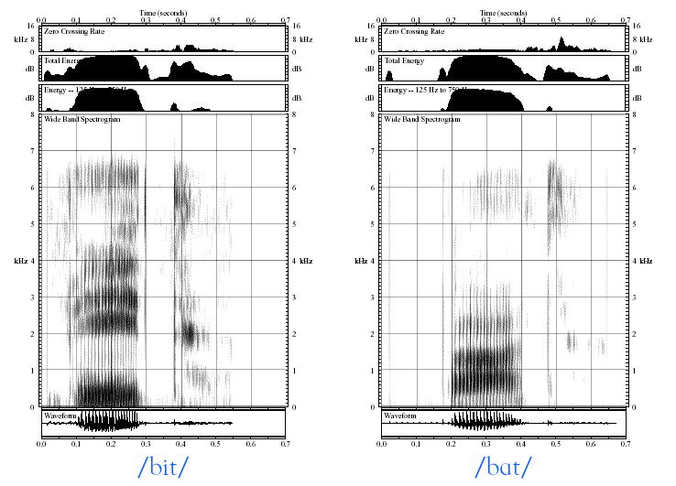
Example of Vowel Spectrograms

Slide 58
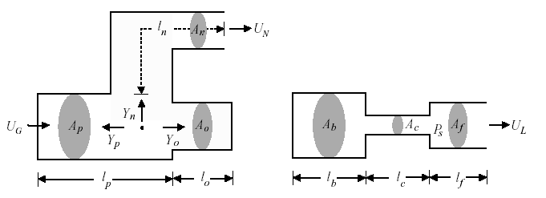
Estimating Anti-Resonance Frequencies (Zeros)
Zeros occur at frequencies where there is no measurable output
For nasal consonants, zeros in U_{N} occur where Y_{o} = ∞
For fricatives or stop consonants, zeros in U_{L} occur where the impedance behind source is infinite (i.e., a hard wall at source)

Slide 59
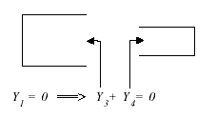
Estimating Anti-Resonance Frequencies (Zeros)
Zeros occur when measurements are made in vocal tract interior as indicated below:

Slide 60
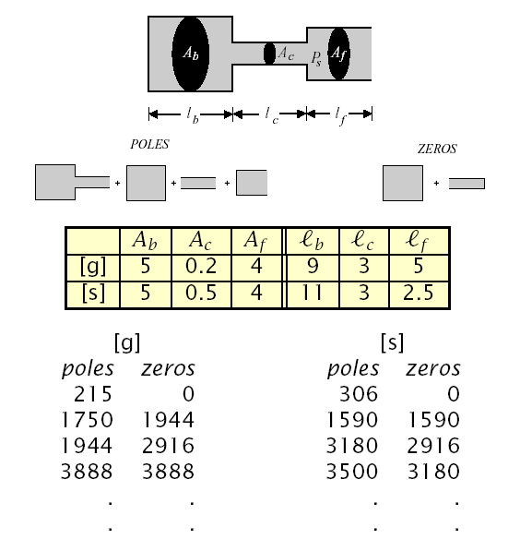
Consonant Production

Slide 61
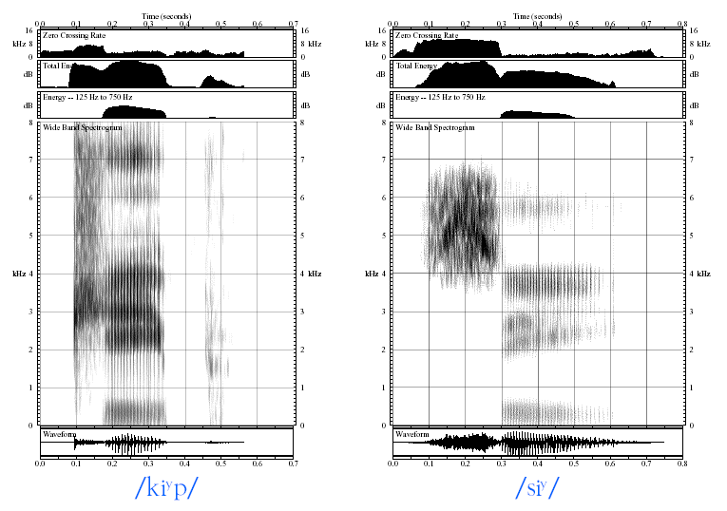
Example of Consonant Spectrograms

Slide 62
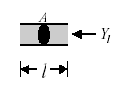
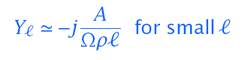
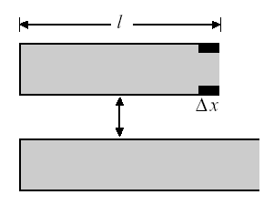
Perturbation Theory
Consider a uniform tube, closed at one end and open at the other.
Reducing the area of a small piece of the tube near the opening (where U is max) has the same effect as keeping the area fixed and lengthening the tube.
Since lengthening the tube lowers the resonant frequencies, narrowing the tube near points where U (x) is maximum in the standing wave pattern for a given formant decreases the value of that formant.

Slide 63
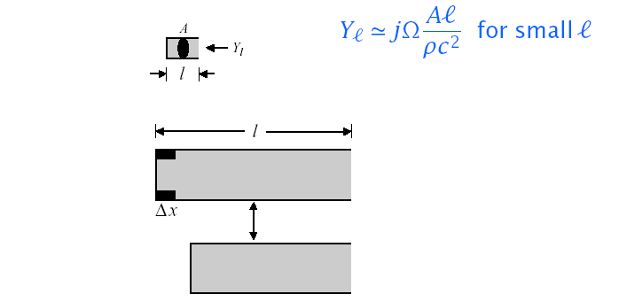
Perturbation Theory (Con’t)
Reducing the area of a small piece of the tube near the closure (where p is max) has the same effect as keeping the area fixed and shortening the tube
Since shortening the tube will increase the values of the formants, narrowing the tube near points where p(x) is maximum in the standing wave pattern for a given formant will increase the value of that formant

Slide 64
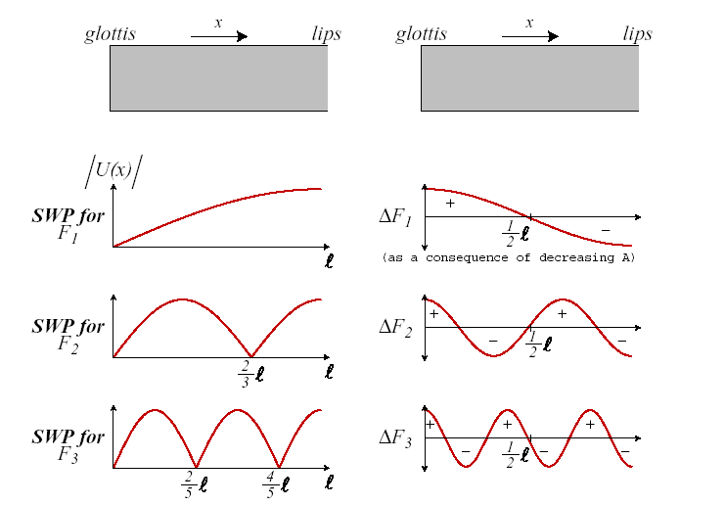
Summary of Perturbation Theory Results

Slide 65
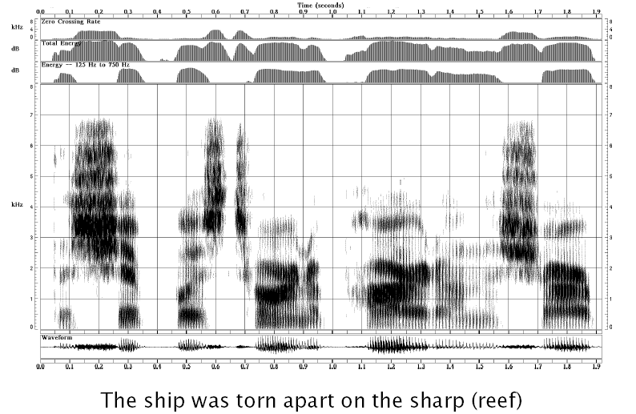
Illustration of Perturbation Theory

Slide 66
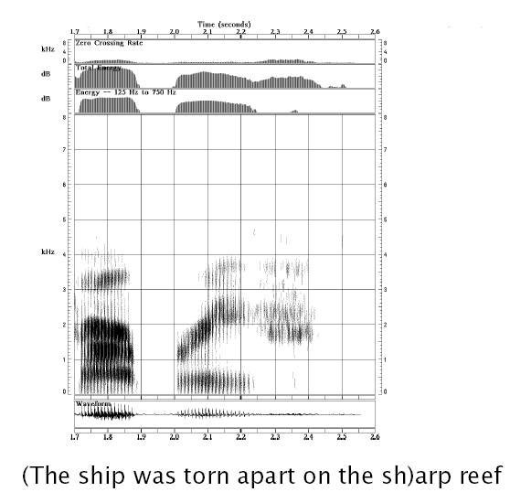
Illustration of Perturbation Theory

Slide 67
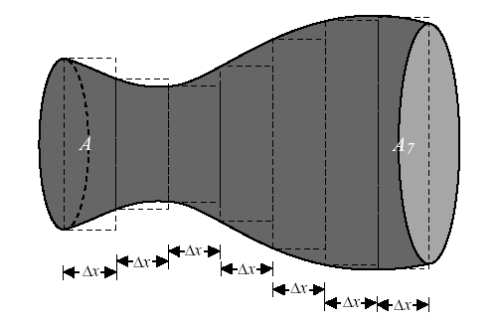
Multi-Tube Approximation of the Vocal Tract
We can represent the vocal tract as a concatenation of N lossless tubes with constant area {Ak}.and equal length Δx = l/N
The wave propagation time through each tube is τ =Δx/c = l/Nc

Slide 68
A Discrete-Time Model Based on Tube Concatenation
Frequency response of vocal tract, V_{a}(Ω)=U(l,Ω)/U_{g}(Ω), is easy to obtain due to linearity of the model.
Radiation impedance can be modified to match observed formant bandwidths.
Concatenated tube model leads to resulting all-pole model which in turn leads to linear prediction speech analysis.
Draw back of this technique is that although frequency response predicted from concatenated tube model can be made to approximately match spectral measurements, the concatenated tube model is less accurate in representing the physics of sound propagation than the coupled partial differential equation models.
The contributions of energy loss from:
Vibrating walls
Viscosity,
Thermal conduction, as well as
Nonlinear coupling between the glottal and vocal tract airflow,
Are not represented in the lossless concatenated tube model.

Slide 69
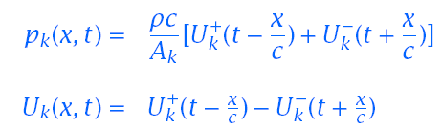
Sound Propagation in the Concatenated Tube Model
Consider an N-tube model of the previous figure. Each tube has length l_{k} and cross sectional area of A_{k}.
Assume:
No losses
Planar wave propagation
The wave equations for section k: 0≤x≤l_{k} are of the form:
where x is measured from the left-hand side (0 ≤x ≤Δx)

Slide 70
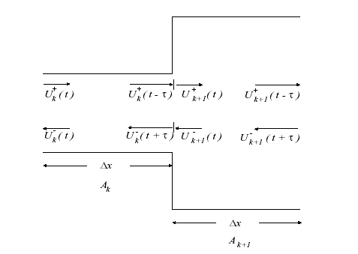
Sound Propagation in the Concatenated Tube Model
Boundary conditions:
Physical principle of continuity:
Pressure and volume velocity must be continuous both in time and in space everywhere in the system:
At k’th/(k+1)’st junction we have:

Slide 71
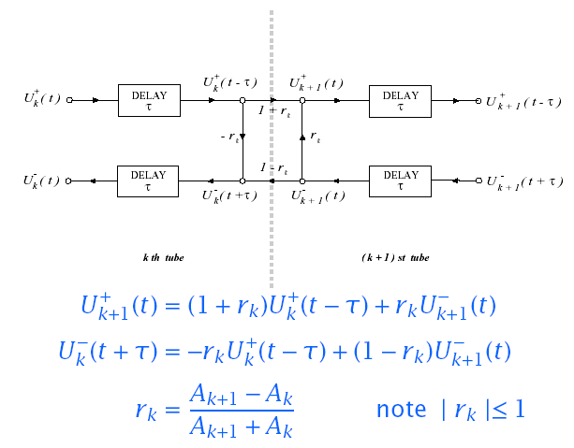
Update Expression at Tube Boundaries
We can solve updated expressions using continuity constraints at tube boundaries e.g., p_{k}(Δx,t)= p_{k+1}(0,t),and U_{k}(Δx,t)= U_{k+1}(0,t)

Slide 72


Digital Model of Multi-Tube Vocal Tract
Updates at tube boundaries occur synchronously every 2τ
If excitation is band-limited, inputs can be sampled every T =2τ
Each tube section has a delay of z^{-1/2}.
The choice of N depends on the sampling rate T

Slide 73

Format Frequencies of Various Resonators.

Slide 74
Haskins Laboratory

Slide 75
Measuring and Modeling Speech Production
Three different vocal tract shapes are shown (next slide) corresponding, from top to bottom, to the vowels:
"ah" (/a/),
"ee" (/i/), and
"oo" (/u/).
In this example, schematized vocal tract shapes from the “Haskins Laboratories” articulatory synthesizer were used.

Slide 76

Measuring and Modeling Speech Production

Slide 77
Measuring and Modeling Speech Production
Plotted in the same graph for each tract shape is
the smoothed transfer function that is computationally derived by the synthesizer, and
the hypothetical energy spectrum that would result from using these functions to filter a glottal source spectrum with a fundamental frequency of 100 Hz.
Note that although all three vowels have the same fundamental frequency, their spectra differ according to the filter characteristics of the different vocal tract shapes.

Slide 78
Acoustic Theory of Speech Production
References
Rabiner, L., Schafer, R., Theory and Applications of Digital Speech Processing, 2010.
Stevens, Acoustic Phonetics, MIT Press, 1998.
Rabiner & Schafer, Digital Processing of Speech Signals, Prentice-Hall, 1978.
Quatieri, Discrete-time Speech Signal Processing Principles and Practice, Prentice-Hall, 2002

Slide 79
END

